Slide 1
LE26-110 What's new: Enhanced Analysis Mode
Kennie Nybo Pontoppidan
Blanca Robledo

Slide 2
Business Value
Smarter apps
Include analysis views with your apps/extensions
Built-in insights
Users can analyze their data with pre-built analysis views
Notes:
LE25-100

Slide 3
Enhanced Analysis Mode (highlights)
Support for analysis views in AL
Analysis view descriptions
Added analysis tabs to Business Central application

Slide 4
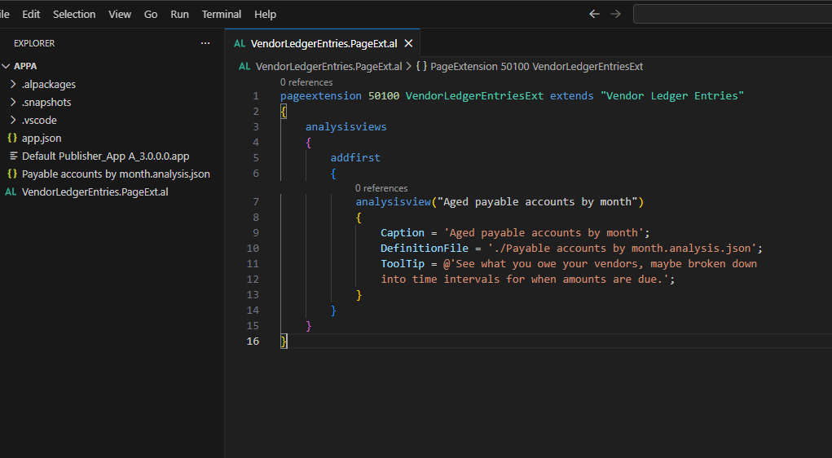
Support for analysis views in AL
Export your analysis view as an <AnalysisView>.analysis.json file.
In your AL extension, use the new `analysisviews` control syntax.
Add the .analysis.json file and point to it using the DefinitionFile property.

Slide 5
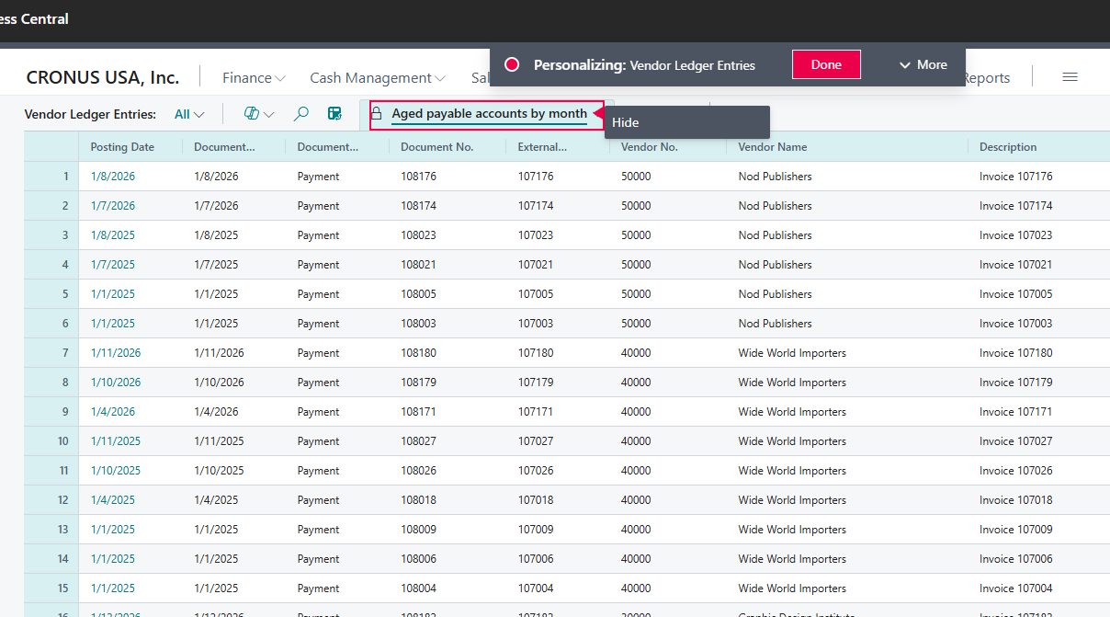
Designer and Personalization support
Use the in-client Designer, Personalization and Profile Configuration modes to show or hide analysis views from AL extensions in environments, users and profiles.

Slide 6
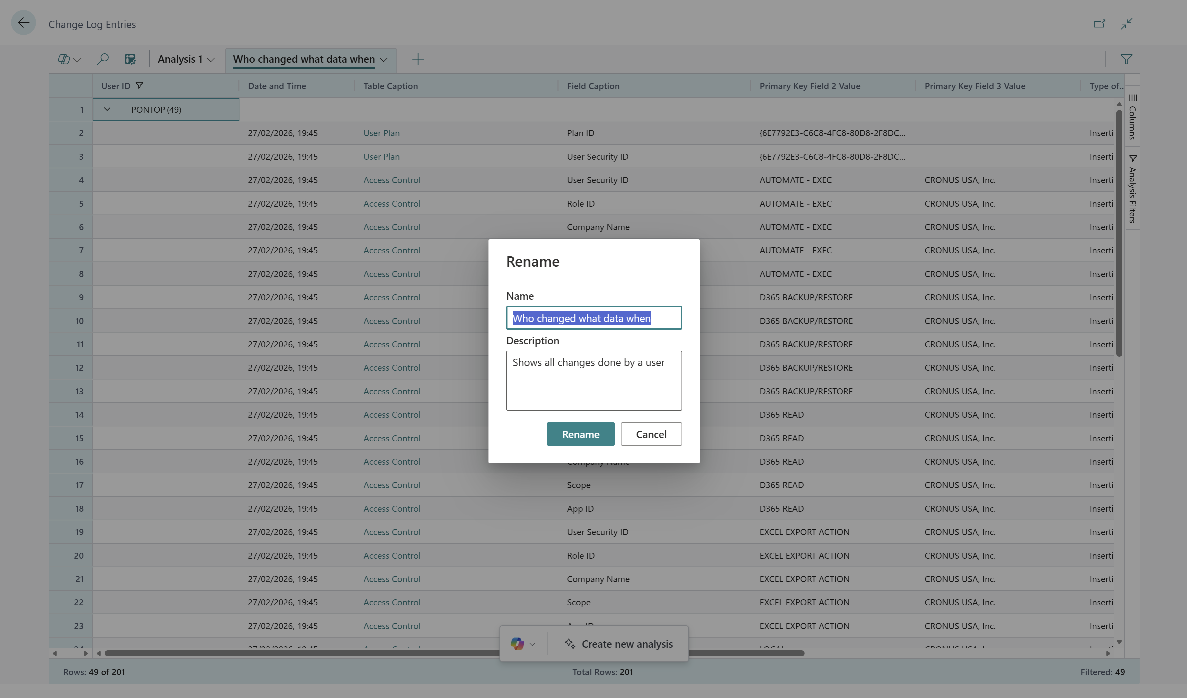
Analysis view descriptions
Add tooltips for your analysis views

Slide 8
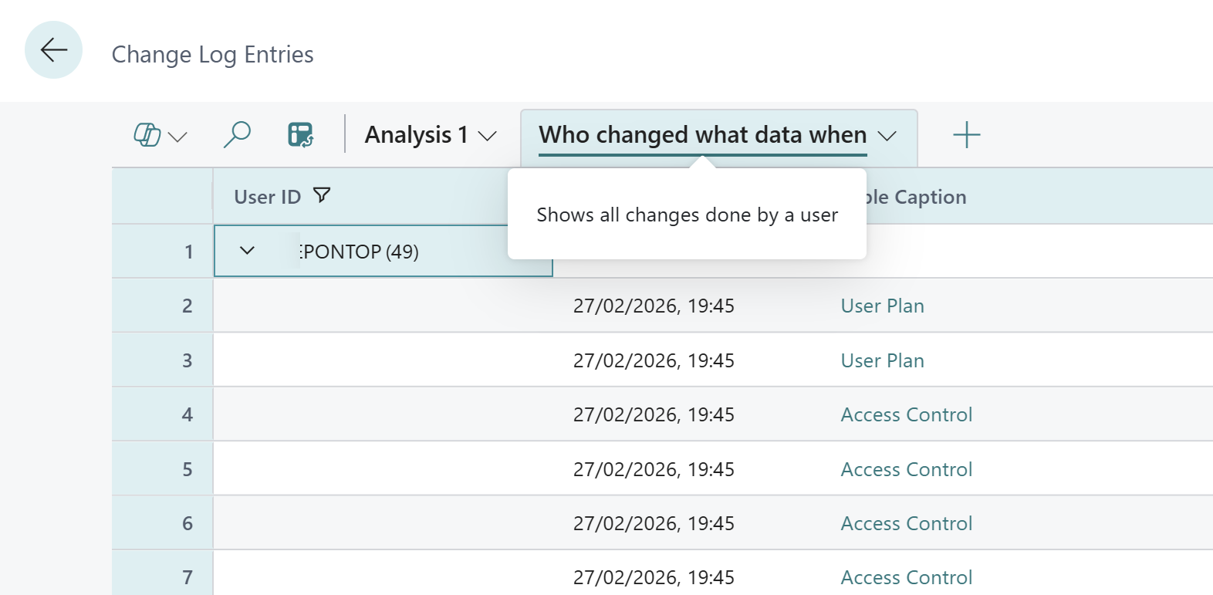

Slide 9
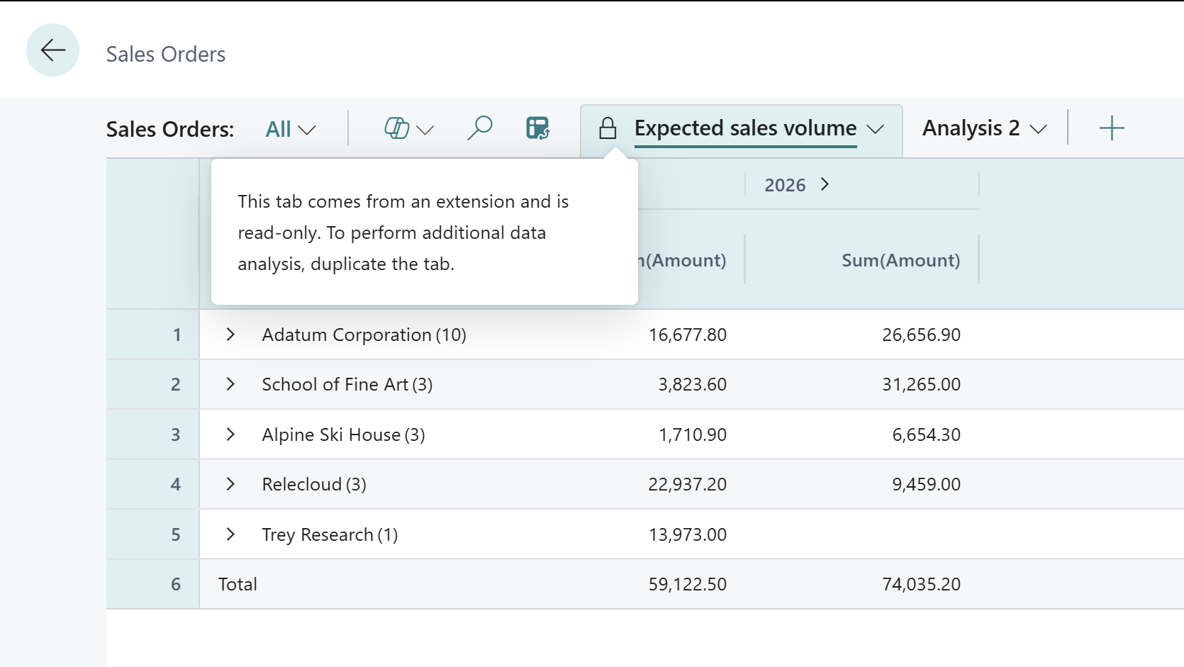
Added analysis tabs to Business Central application (28.x)
Sales
Auditing
Finance
Inventory
Purchasing

Slide 10
Analysis tabs added to Sales (28.x)
Sales orders
  Expected sales volume
  Customer sales by volume
  Aged accounts by month

Slide 11
Analysis tabs added to security pages (28.x)
Change Log Entries
  Who changed what data, and when
  Data changes by table & field
Users
  Users by status
  Users by licence type

Slide 12
Analysis tabs added to finance pages (28.x)
GL registers
  GL entries by source
Fixed Assets Ledgers
  Fixed Assets (current value)
  Asset value changes over time
  FA depreciations over time

Slide 13
Analysis tabs added to inventory pages (28.x)
Item Ledger Entries
  Inventory on hand
  Inventory throughput
  Inventory movements
  Returned items by return reason

Slide 14
Analysis tabs added to purchasing pages (28.x)
Item Ledger Entries
  Inventory on hand
  Inventory throughput
  Inventory movements
  Returned items by return reason

Slide 15
Analysis tabs added to inventory pages (28.x)
Vendor Ledger Entries
  Aged payable accounts by month
  Payments on hold - Analysis
  Payments on hold (normal view, not an analysis view)
Purchase lines
  Goods received, not invoiced

Slide 16
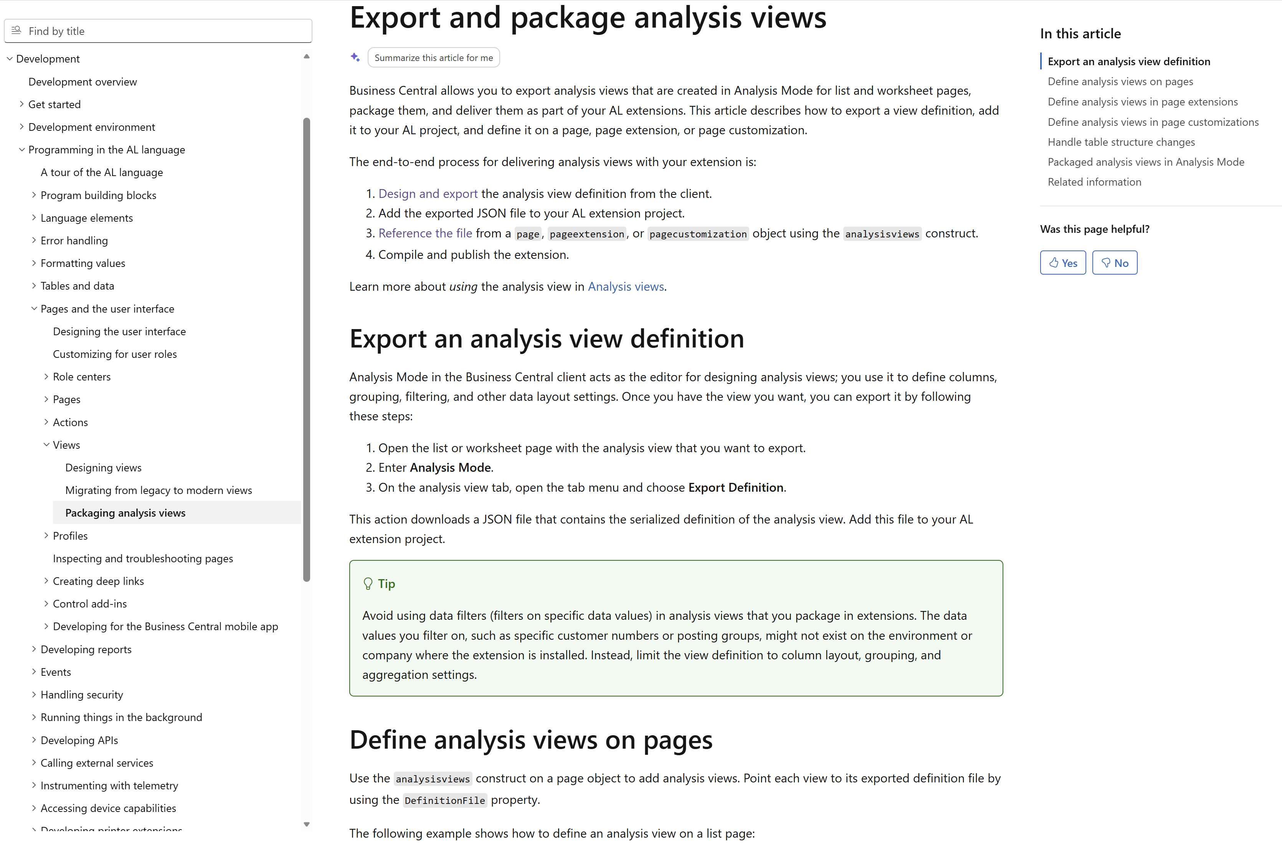
Want to learn more?
aka.ms/bcDeveloper

Slide 18
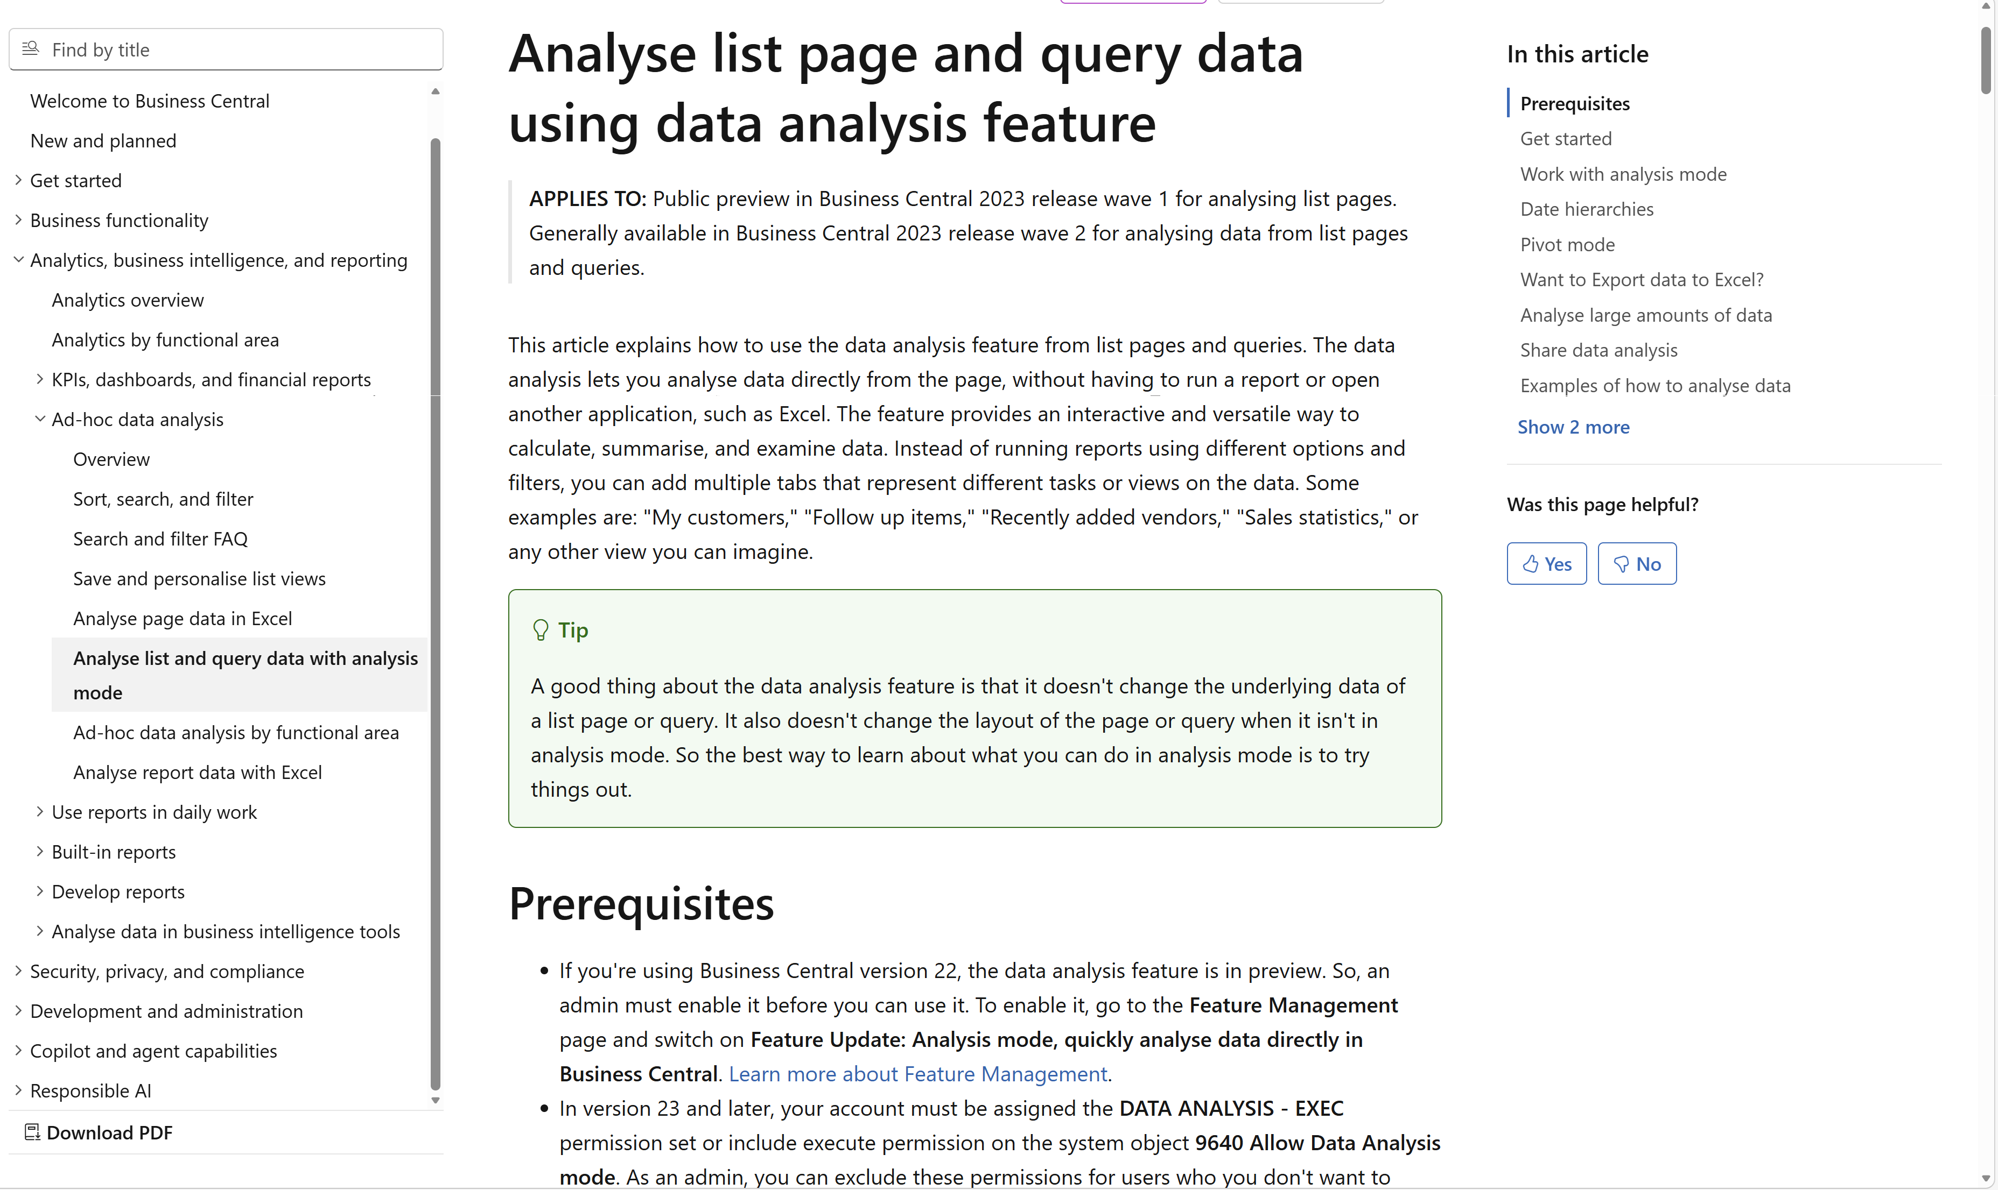
Want to learn more?
aka.ms/bcAnalytics

Slide 19
Notes:
https://learn.microsoft.com/dynamics365/business-central/analysis-mode

Slide 20
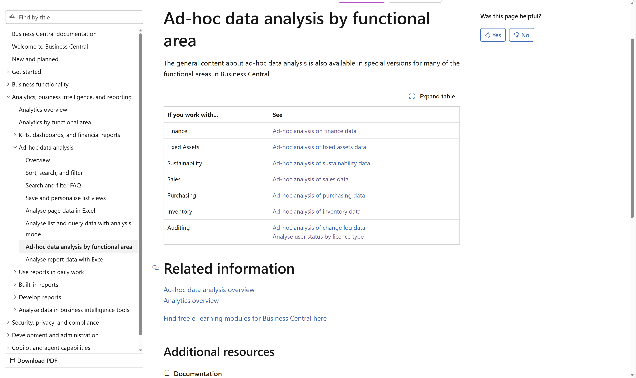
Notes:
https://learn.microsoft.com/dynamics365/business-central/ad-hoc-data-analysis-by-functional-area

Slide 21
Related sessions
What's new: Enhanced sales analytics
What's new: Enhanced inventory analytics
What's new: Enhanced finance analytics
What's new: Enhanced Financial Reporting
What's new: Enhanced subscription billing analytics
What's new: Enhanced Power BI and Excel with Business Central
What's new: Enhanced demo data

Slide 22
General Business Central resources
Learn more!
Looking for resources?
Watch more on YouTube
aka.ms/BCAll
aka.ms/BCYouTube
Join Viva Engage to ask questions
Follow on LinkedIn
aka.ms/BCLinkedIn
aka.ms/BCVivaEngage
Join the office hours
Microsoft page for partners
aka.ms/BCOfficeHours
aka.ms/BCPartnerPortal

Slide 23



LinkedIn
Follow the weekly news and announcements
on the Microsoft Dynamics 365 Business Central page
aka.ms/BCLinkedIn

Slide 24

Watch more videos on YouTube
One-stop shop to watch Business Central videos:
  What is new
  Copilot and AI
  Short tips and tricks
  Technical deep dives
  Under the Hood podcast series
aka.ms/BCYouTube

Slide 25
THANK YOU

